Slide 1
Ortega River – Anchorage Issues
Presentation by Ortega River Homeowners Group

Slide 2
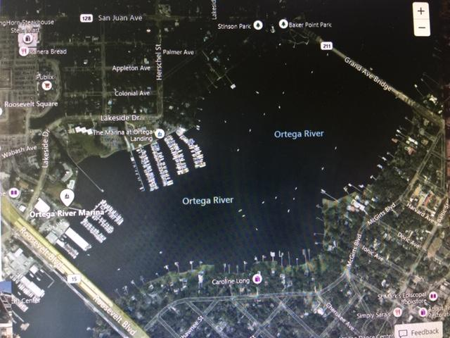

Slide 3
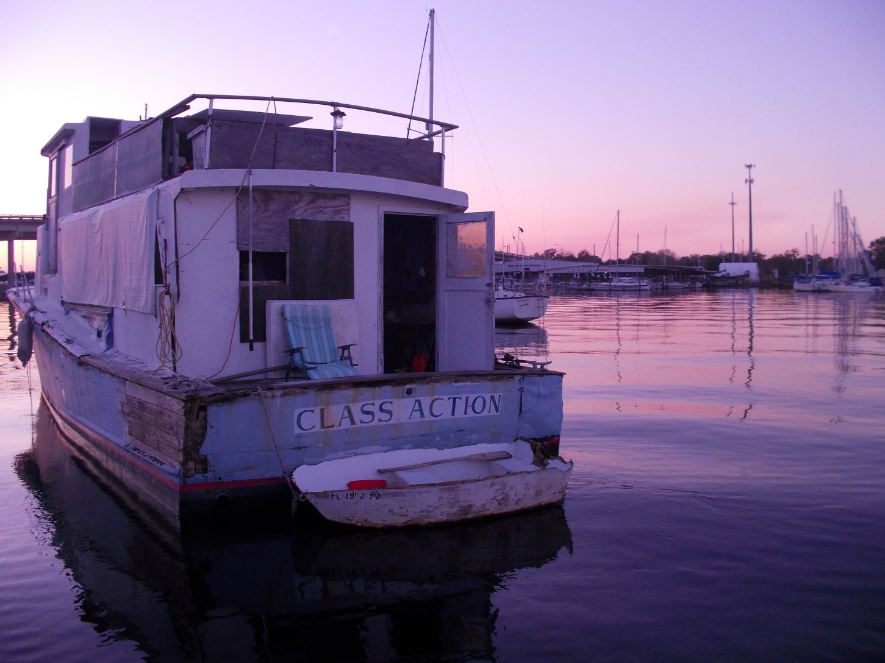

Slide 4
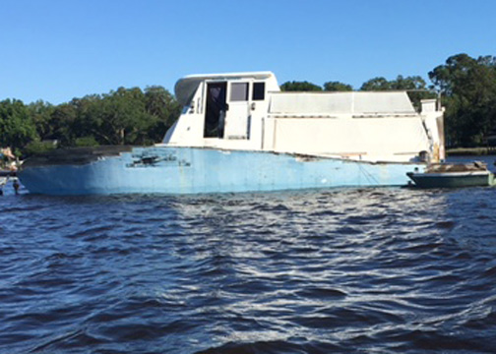

Slide 5
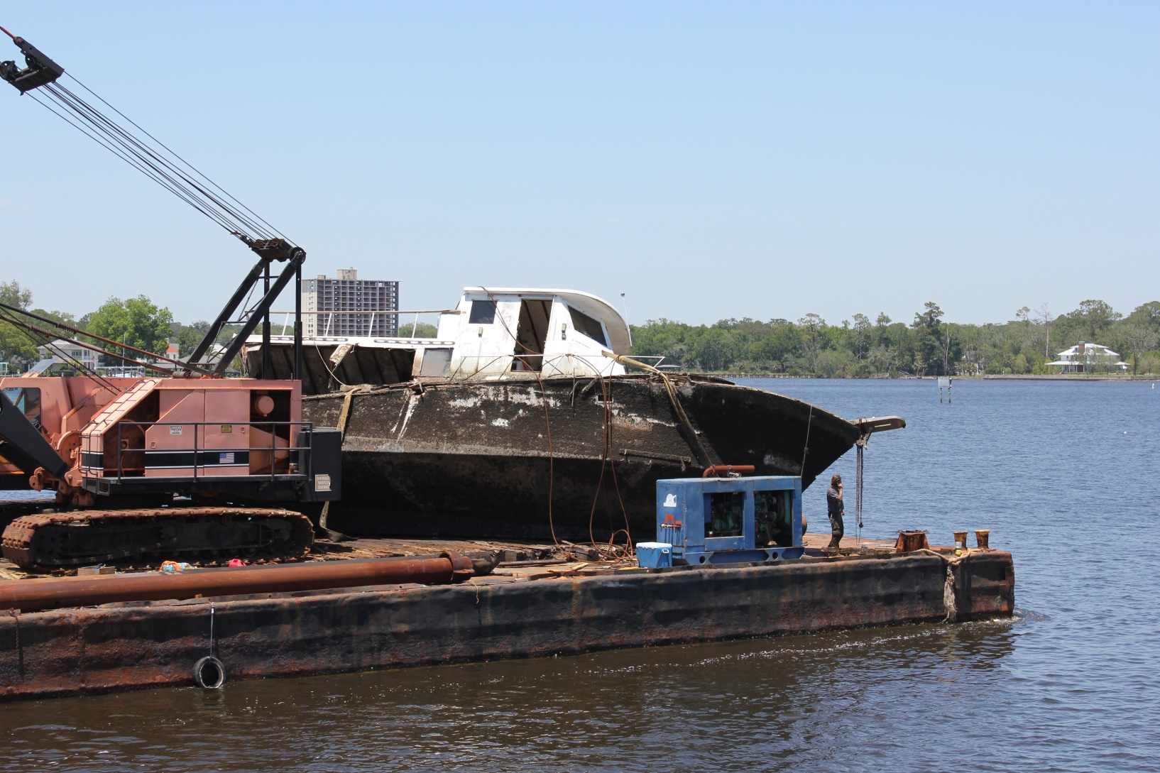

Slide 6
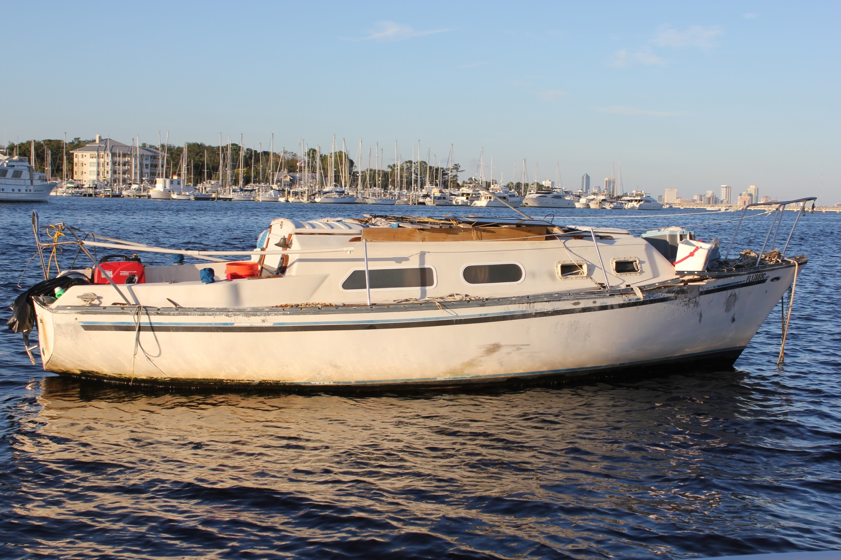
No mast, no motor, hull damage, no registration. Marine sanitation device?

Slide 7
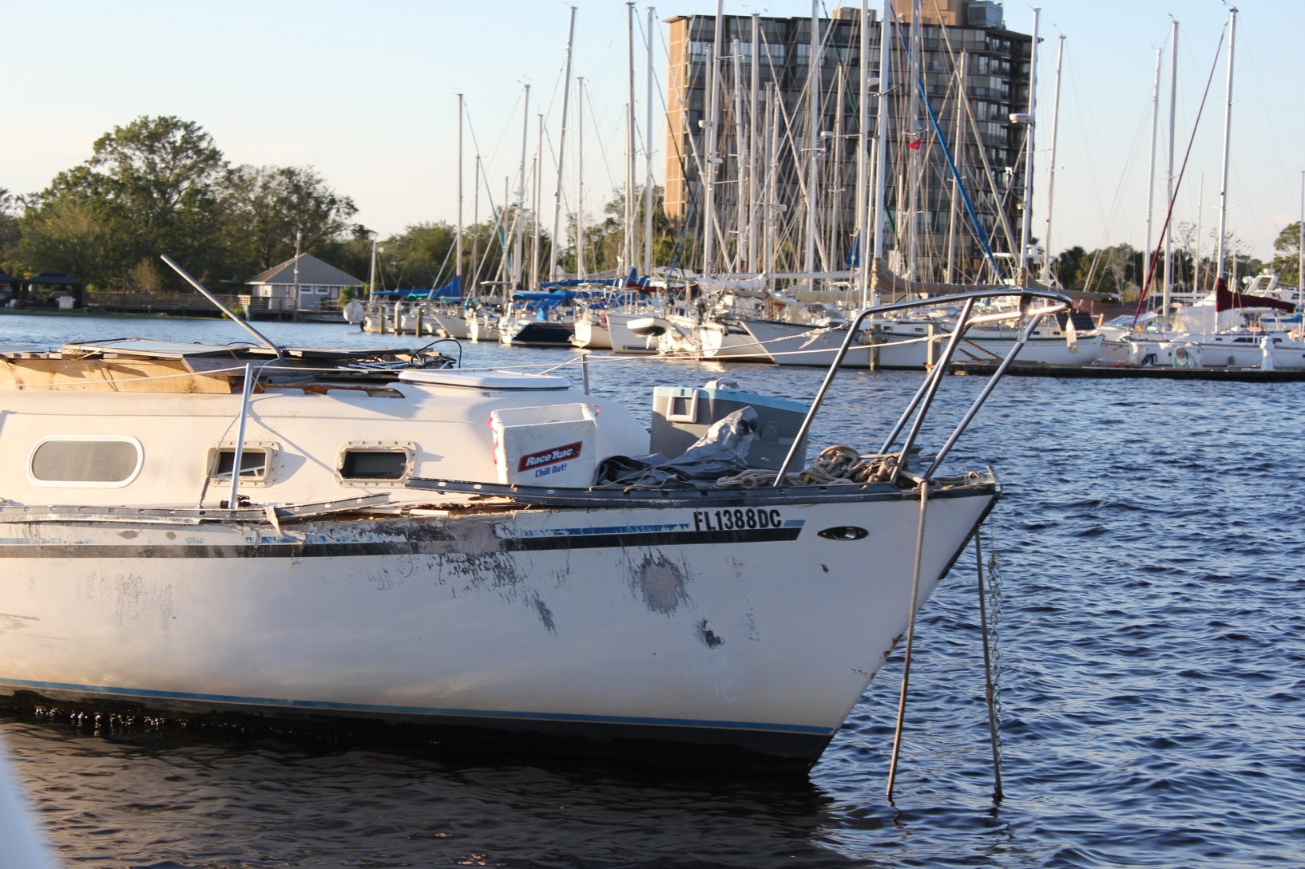
Owner? Insurance?

Slide 8
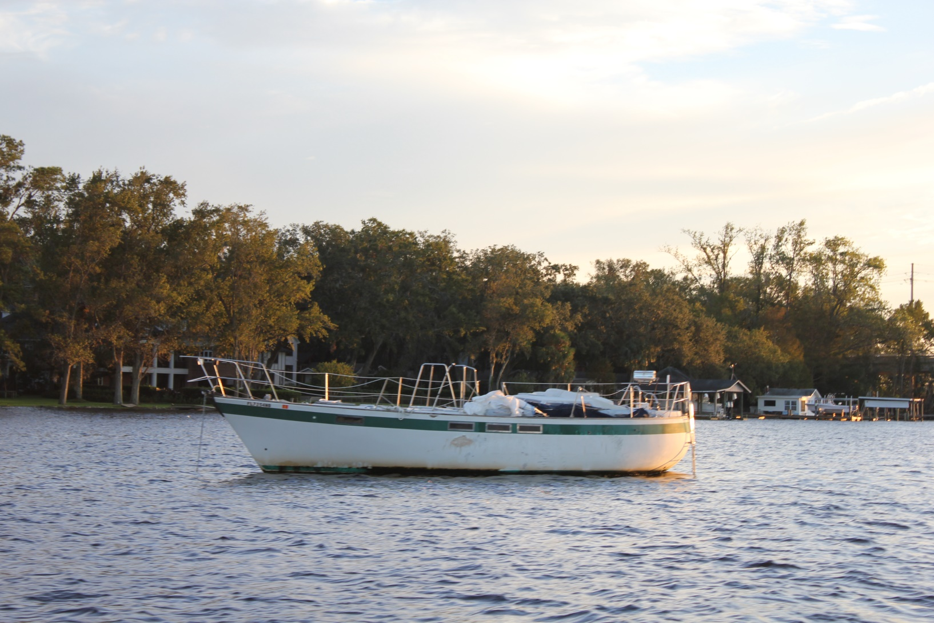
No mast, no motor, no registration, barnacles on hull

Slide 9
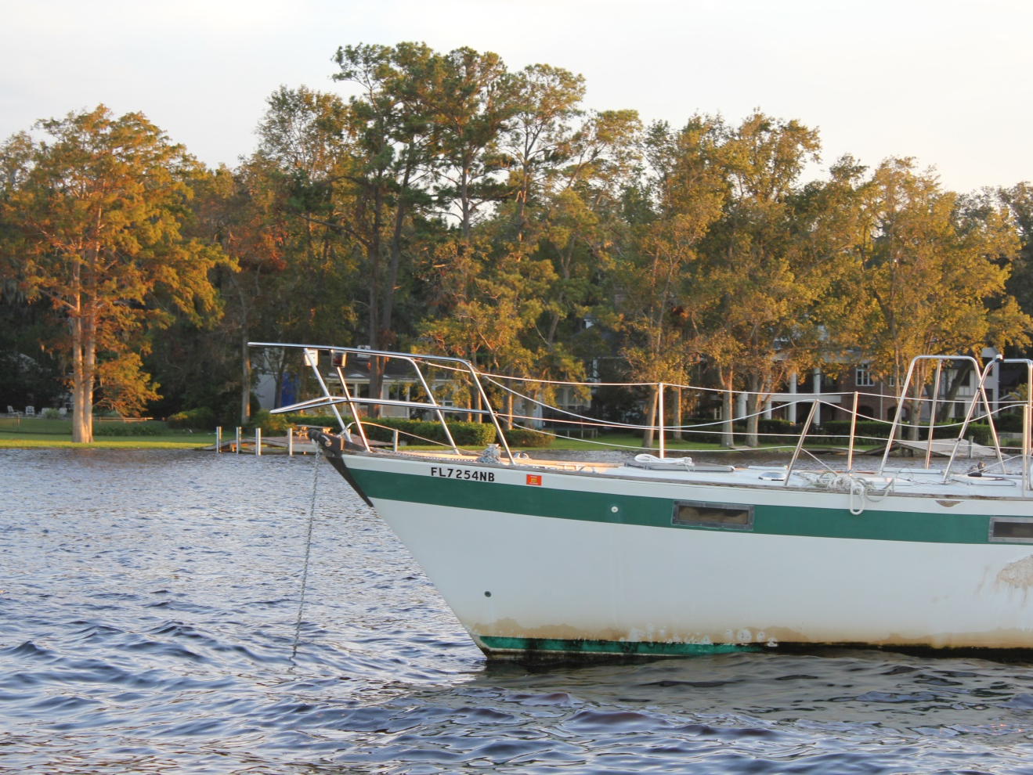

Slide 10
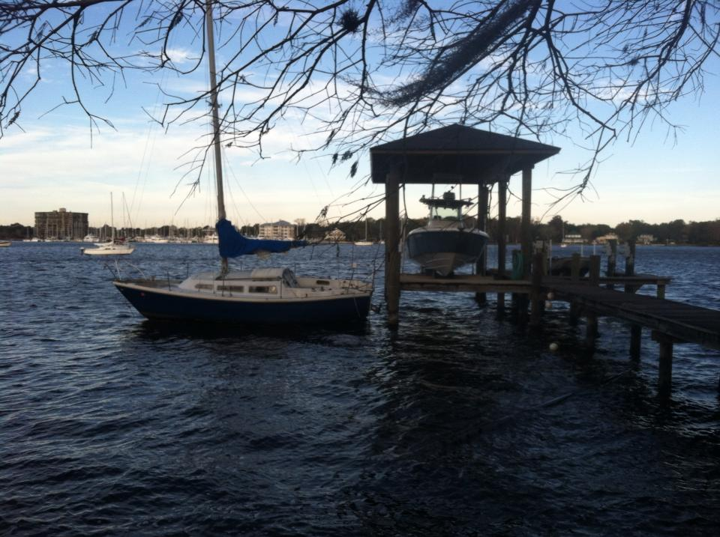
Dragged anchor for weeks. Multiple calls to FWC. “That’s between you and your insurance company.” Homeowner tied off and towed.

Slide 11
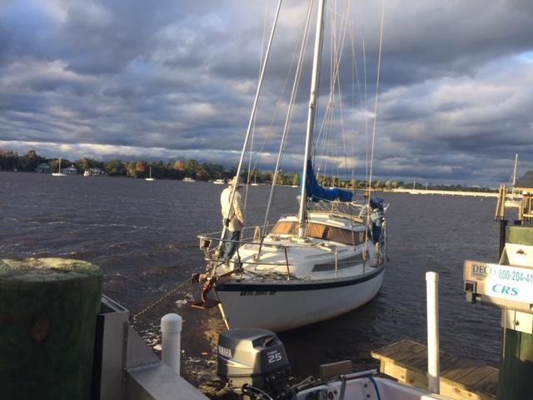
Washed up in storm,broken motor, couldn’t afford tow

Slide 12
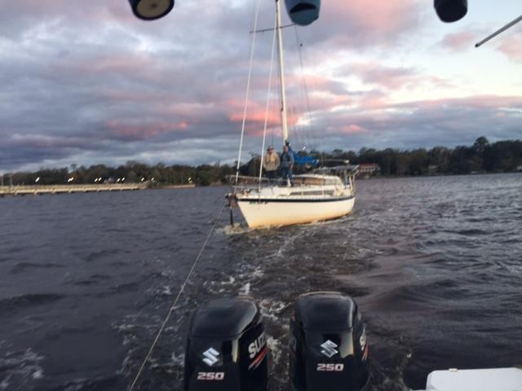

Slide 13
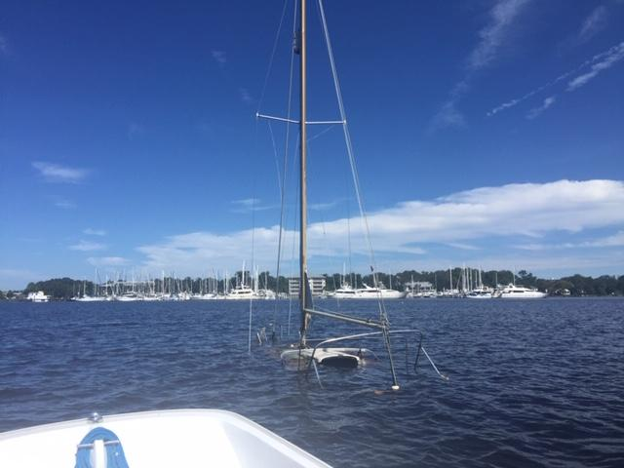
No lights or markers for months until raised.

Slide 14
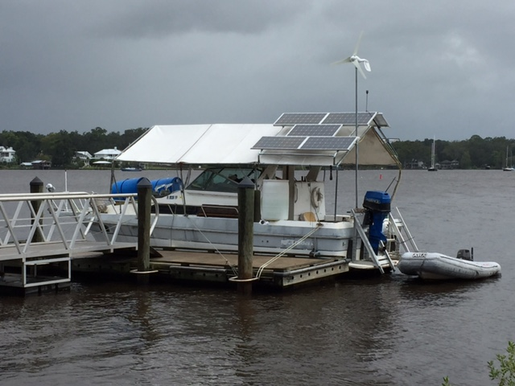
Lashed to city dock during hurricane.
$18K damage to dock/gangway.
“Less than 26’ so no MSD”

Slide 15
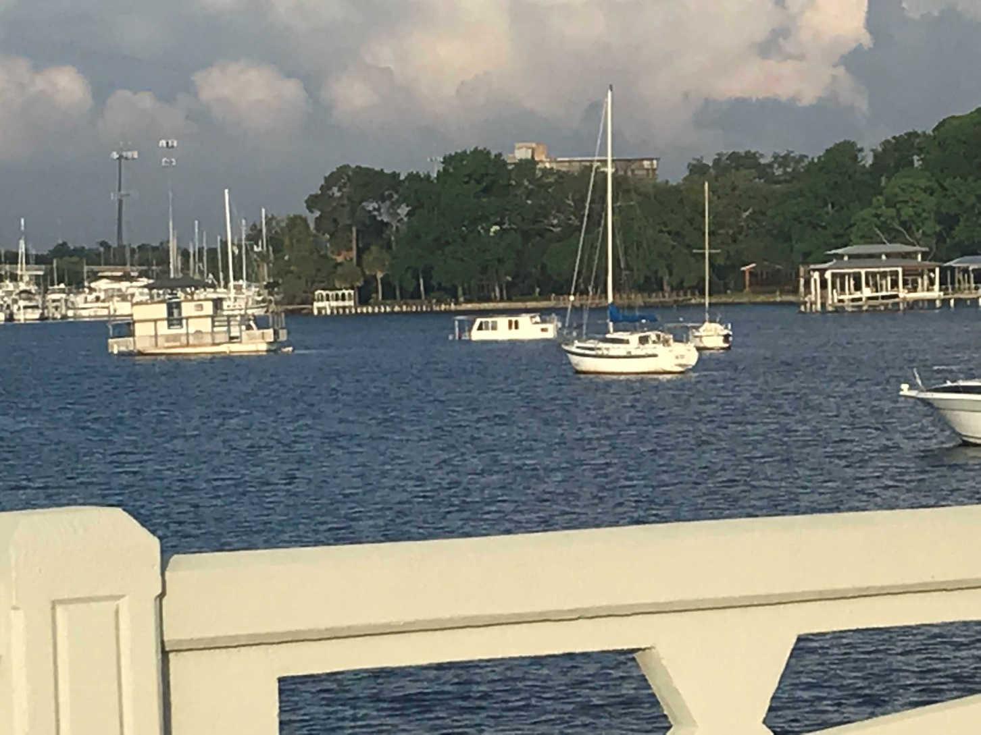
Left: Floating structure (3 years, 9 violations)
Right: Sunken Houseboat (< 24 hours)

Slide 16
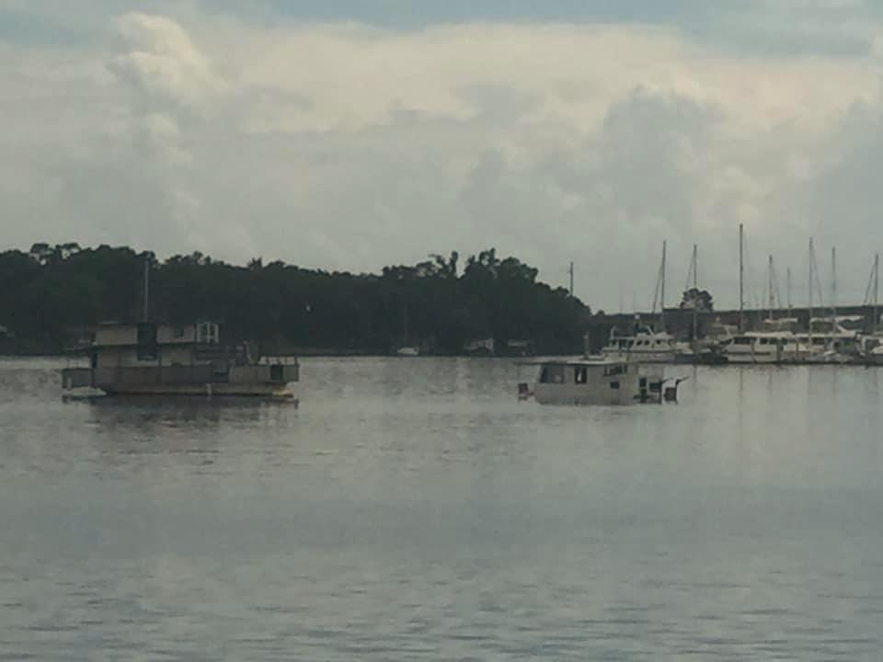

Slide 17
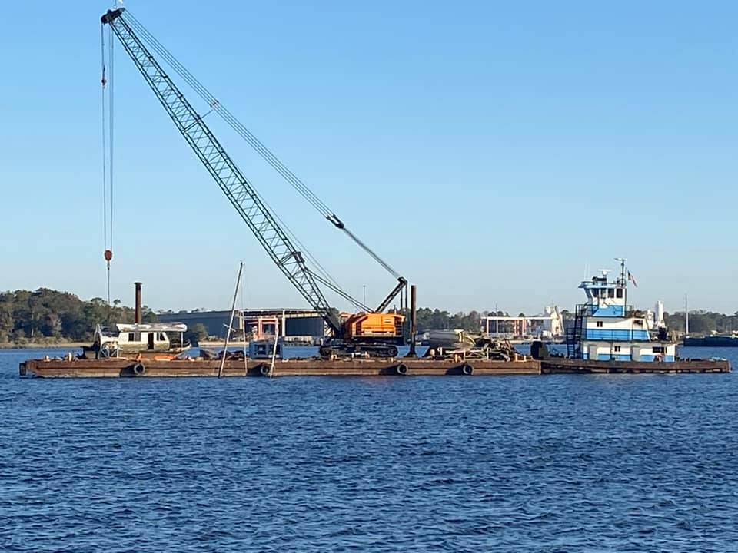
Left: Houseboat
Right: disintegrated Floating Structure
Five months to salvage after sinking. Cost?

Slide 18
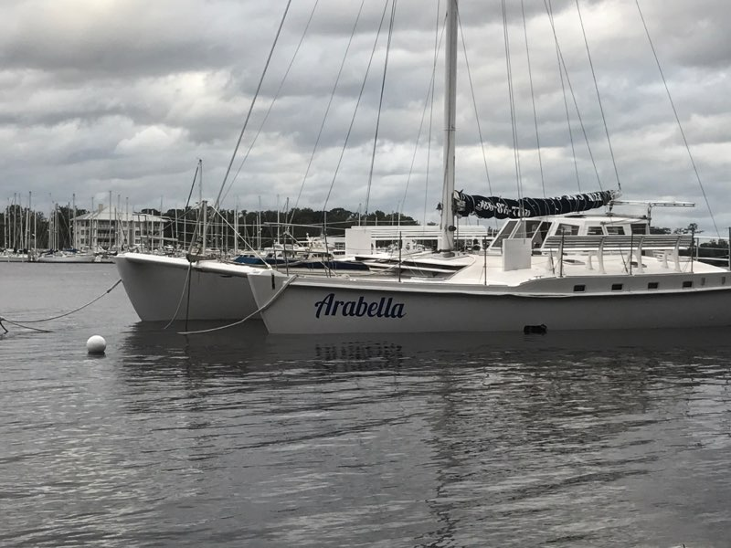

Slide 19
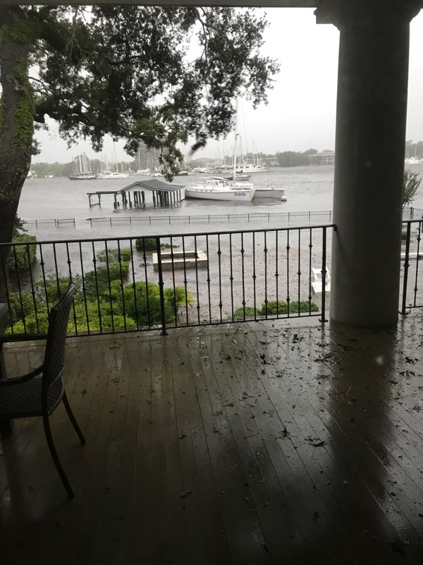
$25K in damage

Slide 20
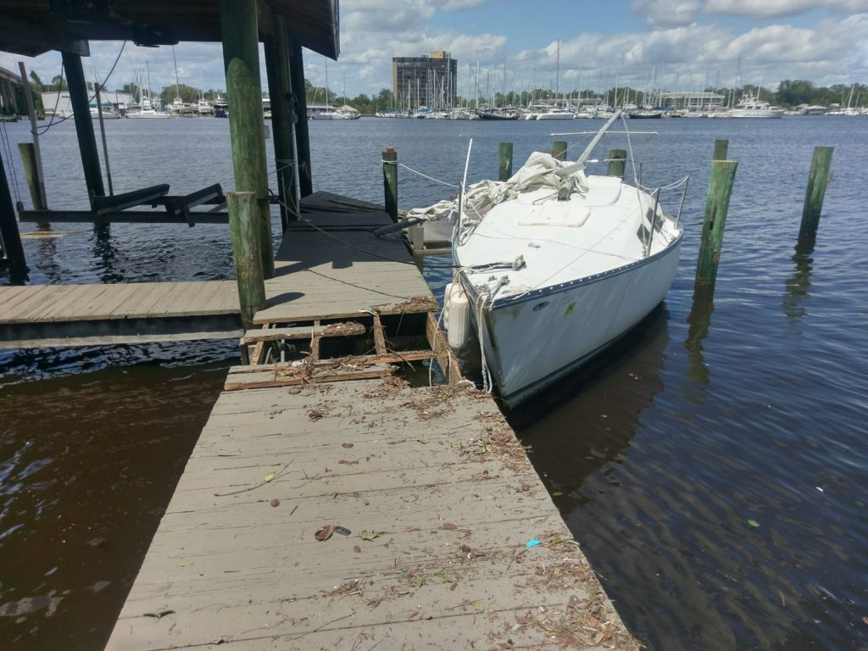
$10K in damage

Slide 21
Jacksonville Waterways Commission
February 5, 2004
“In response to a request for information from Commissioner Bronson Lamb, Jr., Greg Radlinsi, Office of General Counsel, discussed three issues on anchoring in the Ortega River: anchorage; lighting; and the discharge of raw sewage. In his December 13, 2003 memorandum to Commissioners, Attorney Radlinsi said that anchorage is not prohibited unless the boats constituted a hazard to navigation or obstruct passage. If vessels are anchored at night, the vessels are required to have lights. Florida law prohibits the discharge of raw sewage into Florida waterways.”

Slide 22
Issues:
$50 - $70K personal property damage
Unmoored vessel: No law enforcement
Noise from generators
No lighting, navigation hazard
No marine sanitation in heavily used area
Lengthy time to deal with derelict/sunk vessels

